Slide 1
NEONATAL JAUNDICE

Slide 2
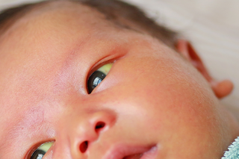
NEONATAL JAUNDICE

Slide 3
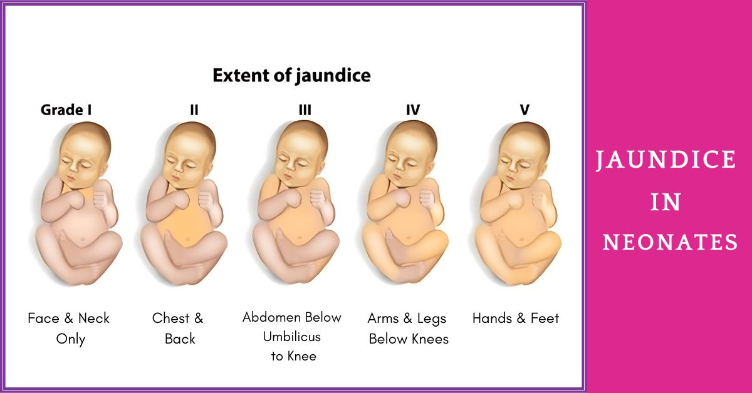

Slide 4
INTRODUCTION
JAUNDICE: Discoloration of body tissue caused by abnormally high levels of bilirubin (> 85 umol/l)
Normal upper limit of bilirubin is 17 umol/l
In Neonates a level of > 26 umol/l to define neonatal hyperbilirubinemia
Hyperbilirubinemia in neonates may be physiological or pathological.

Slide 5
Heme metabolism
Haemoglobin/ other heme proteins
heme
heme oxygenase
biliverdin
biliverdin reductase
bilirubin

Slide 6
Heme metabolism cont
Bilirubin bilirubin/alb complex , albumin albuimin
bilirubin
glucuronic acid UGT
bilirubin mono/diglucuronide
bacterial
enzymes
Stercobilin urobilinogen

Slide 7
Heme metabolism cont
Biliverdin is non toxic and more readily excreted than bilirubin.
However it is poorly transported across placenta hence its conversion to bilirubin which readily crosses into maternal circulation.
Bilirubin is also thought to have an antioxidant role.

Slide 8
Classification of neonatal jaundice
Physiological and pathological
Pathological further classified has;
Prehepatic; congenital hyperbilirubinemia, haemolytic
Hepatic
Post hepatic/obstructive jaundice

Slide 9
PHYSIOLOGIC JAUNDICE
Almost all newborns develop transient unconjugated hyperbilirubinemia (60% of term and 80% preterm)
Usually due to immaturity of hepatic systems (Reduced r.b.c lifespan, increased enterohepatic circulation)
Onset and peak levels determined by
Gestation:
Term –onset day 2-3,peaks 3-4 decline by 10-14
pretems onset day 4,peaks 5-7
Race:-East Asians/Native Americans> Caucasians/Africans
Feeding:-Breastfeed/delayed feeds>Formula
Bruising, Maternal D.M,
Maternal Age > 25y,
infections

Slide 10
PATHOLOGICAL JAUNDICE
Onset, pattern of rise, duration of hyperbilirubinemia differs from physiological jaundice.
Infant is at risk of Toxic effects
Risk factors:
Blood incompatibilities,
male>female,
race ,
prematurity,
asphyxia
maternal D.M, maternal infection,
breastfeed/delayed fed,
siblings hx of delayed passage of stool and colour,

Slide 11
Pathological jaundice cont
Onset; jaundice on day 1(85umol/l)
Rate ; > 85 umol/l/day
Values;
Term- >12mg/dl (~200umol/l)
Preterm- >10-14mg/dl (~170-238)
Direct bilirubin >17umol/l
Persistence 10-14 days
Presence of symptoms and risk factors; pallor, splenomegaly, hepatomegaly, vomiting, poor feeding, abnormal wt loss, apnoea, bradycardia, hypothermia, pale stools, dark urine. Signs of encephalopathy

Slide 12
ETIOLOGY
i) Overproduction of Bilirubin
Haemolysis
Blood incompatibilities (ABO,Rhesus): Fetal Rbc antigens mix with maternal blood with resultant sensitisation and formation of antibodies against fetal rbc. In ABO prior sensitisation not necessary due to natural antigens
Membranopathies e.g congenital spherocytosis
Enzymopathies: G6PD def and Pyruvate Kinase def.
These enzymes important in HMP shunt and Embden meyerhof pathways vital for rbc metabolism. G6PD def causes hemolysis in oxidantion stress eg sepsis drugs.

Slide 13
Etiology cont
DIC: Progressive coagulation cascade hence consumption of factors and formation of fibrin mesh causing mechanical lysis
Others rbc lifespan less in neonate
polycythemia- increased load of Hb ;SGA ,maternal DM ,twin transfusion,
ii) Defective hepatic uptake:
Drugs
inhibit bilirubin binding to ligandin eg flavaspidic acid. Novobiocin also interferes with uptake. Variant of Gilbert’s syndrome.

Slide 14
Etiology cont
iii) Conjugation abnormalities:
Immaturity of enzyme systems: in utero bilirubin is eliminated through placenta and absorbed into maternal circulation.
Neonatal period is a transition which matures in 10-14 days.
Lack of UGT ;
Gilbert’s syndrome; autosomal dominant with variable penetrance ( low UGT-1levels)
Criggler-Najjar-I autosomal recessive; absolute lack of UGT. Type II autosomal dominant: partial def
c) Interference with UGT activity: Energy dependent so impaired by hypoxia, hypothermia, hypoglycemia, sepsis’ and hypothyroidism (the latter also delays enzyme maturation)

Slide 15
Etiology cont
.
iv) Defective excretion(mixed hyperbilirubinemia)
Sepsis, TORCHES.
Obstruction e.g biliary atresia, choledochal cyst
Dubin johnson- defective transport
Rotor syndrome- defective storage
Cystic fibrosis,
V) increased enterohepatic circulation
Lack of gut flora to convert bilirubin to urobilinogen.
Presence of glucuronidase in B/milk. B/’milk also has UGT inhibitor (pregnane-3B20-diol)

Slide 16
Bilirubin encephalopathy/kernicterus
CNS syndrome caused by bilirubin deposition in the Basal ganglia and brain-stem nuclei
In the brain bilirubin exerts toxicity by interfering with oxygen utilization (pattern similar to hypoxic injury). Uncouples oxidative phosphorylation and blocks ATP production(postulate)
It causes neuronal loss, gliosis, fibre atrophy of involved region. Non-pigmented regions may also be damaged.

Slide 17
Determinants of injury
Serum levels of unconjugated bilirubin which crosses BBB to cause toxicity
Serum albumin levels. Alb/bil comlex does not cross BBB. Hypoalbuminemia worsens toxicity
Competitive binding of albumin by other cpds worsen condition e.g ASA ceftriaxone, FFAs
BBB immaturity
Acidosis : H+ causes dissociation of bilirubin from alb then reacts with it to form bilirubinic acid Which is more toxic
hypoxia :prior hypoxic injury aggravates bilirubin toxicity
Neuronal susceptibility: Lipid rich regions of brain more susceptible e.g brainstem,basal ganglia.

Slide 18
Effects
Acute:-
Early (day 1and2) ;Lethargy, hypotonia ,poor suckling, fits
Intermediate (mid wk 1) hypertonia ,stupor ,irritability ±fever, high pitched cry, retrocollis, opisthotonus
Advanced (>wk 1) pronounced retrocollis, opisthotonus shrill cry, apnea, fever, stupor, coma.
Chronic:
1st year hypotonia, active deep tendon reflexes, obligatory tonic neck reflexes, delayed motor skills.
> 1st year; Athetoid cerebral palsy, tremor, ballismus, high tone deafness, subtle intellectual impairment

Slide 19
Diagnosis
History
Physical exam
Investigations
Serum bilirubin levels (total)
Liver function test
Full hemogram
Direct Coombs test
Blood group and rhesus factor (maternal and infant)

Slide 20
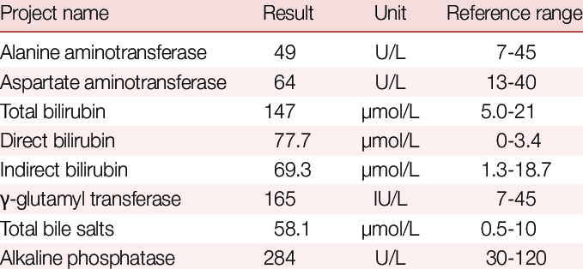
Liver function test

Slide 21
Management
Poor milk intake and dehydration will exacerbate jaundice and should be corrected.
Phototherapy is the most widely used therapy, with exchange transfusion for severe cases.
Light (wavelength 450 nm) from the blue-green band of the visible spectrum converts unconjugated bilirubin by photodegradation into a harmless water-soluble pigment.
It is delivered with an overhead light source placed at the optimal distance 30-45cm above the infant to achieve high irradiance. Although no long-term sequelae of phototherapy from overhead light have been reported, it is disruptive to normal nursing of the infant and should not be used indiscriminately.
The infant's eyes are covered, as bright light is uncomfortable.
Phototherapy can result in temperature instability as the infant is undressed, a macular rash and bronze discoloration of the skin if the jaundice is conjugated, dehydration and retina damage.

Slide 22
Phototherapy
Assess for jaundice in bright, natural light if possible, check the eyes, blanched skin on nose and the sole of the foot
Always measure serum bilirubin if age < 24 hours and if clinically moderate or severe - Any jaundice if aged <24hrs needs further investigation and treatment
Refer early if jaundice in those aged <24hrs and facility cannot provide phototherapy and exchange transfusion
If bilirubin measure unavailable start phototherapy:
In a well baby with jaundice easily visible on the sole of the foot
In a preterm baby with ANY visible jaundice
In a baby with easily visible jaundice and inability to feed or other signs of neurological impairment and consider immediate exchange transfusion
Stop phototherapy – when bilrubin 50 micromol/L lower than phototherapy threshold (see next page) for the baby’s age on day of testing

Slide 23
Phototherapy cont
Ensure adequate hydration and nutrition,
Cover the eyes.
Complications ; erythematous macular rash, chills, overheating, deh20, loose stool, bronze baby syndrome.
Prophylactic photoRx for VLBW has been shown to lower peak levels to half those who don’t get it.
Maximal intensive photoRx: special blue light, 15-20 cm from infant, fibreoptic blanket.

Slide 24
Other mx
Antibiotics in sepsis
IV fluids
Breast feeding
EBM

Slide 25
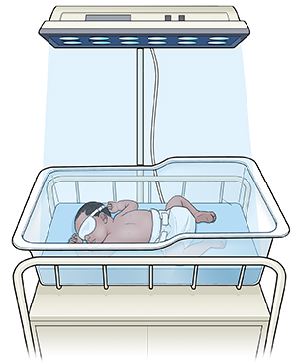
Phototherapy

Slide 26
Exchange transfusion
Exchange transfusion is required if the bilirubin rises to levels which are considered potentially dangerous, particularly if there is associated anaemia from haemolysis or the serum albumin is low.
Exchange transfusions have been performed traditionally via an umbilical venous catheter by alternately withdrawing 10-20 ml of the baby's blood and replacing them with donor blood

Slide 27
EXCHANGE TRANSFUSION
Isovolumetric replacement of patient’s blood with fresh blood,
indications include; Hb<11g/di, Bil> 80 umol/l)
later it is determined by absolute levels of bilirubin ,rate of rise, gestation and intercurrent illness. usually twice infant’s vol (85umol/l)
Complications: Acidosis, hypoglycemia, GVHDz, NEC, thrombocytopenia, vol overload, arrhythmias,
OTHER RX
Phenoborbitone:- enzyme inducer used in type II Crigler-Najjar and Gilberts syndrome
Tin-protoporphryn-heme oxygenase inhibitor

Slide 28
Term neonates
 | No haemolysis Well child | Haemolysis Likely / sick child
photoRx | 290-325 umol/l | 220-255 umol/l
Exchange transfusion | 425-500umol/l | 290-375umol/l

Slide 29
preterms
 | photoRx | Exchange transfusion
<1500 g | 85-90 | 220-275
1500-1999g | 140-200 | 275-300
2000-2499 | 190-240 | 300-340

Slide 30
phototherapy
Age in hours | Bilirubin levels Umol/l
12 | 170
12-17 | 204
18-23 | 238
>24 | 255

Slide 31
END

